Slide 1
WHAT INDIVIDUALS WANT
AND WHAT THE DALLAS REGION
HAS TO OFFER
Notes:
Topic: What individuals and families relocating want and what the Dallas Region has to offer
Description: The Dallas Regional Chamber (DRC) is committed to the attraction of talented workers from around the world. Say Yes To Dallas is a marketing and communications campaign showcasing all that the Dallas Region has to offer to individuals and families relocating to the Dallas Region, including vast job opportunities, parks and outdoors, culture, and day-to-day living, communities, and quality of life. During this session, you will learn about the campaign and how to use Say Yes To Dallas as your resource to spark conversations with prospective clients about why the Dallas Region is the best place to start or continue a career, raise a family, and experience a high standard of living at an affordable cost. Topics during the discussion include:
· Overview of Talent Attraction initiative and the Say Yes To Dallas campaign
· Available resources you can use when relocating individuals and family members from outside the Dallas Region
· Statistics from nationwide survey including factors most important to them when relocating to the Dallas region
· What’s new in the Dallas Region you can showcase to relocating clients

Slide 2
DALLAS REGIONAL CHAMBER

Slide 3
WHY IS DALLAS SO ATTRACTIVE?
DIVERSE ECONOMY
ONLY 6% OF
ECONOMY IS ENERGY
RELATED
COLLEGE GRADUATES
353,825
Students enrolled in higher education in Dallas Region.
44,848
Number of Bachelors, Masters and PhDs.
2 GREAT AIRPORTS
AFFORDABILITY:
0% LOCAL INCOME TAX
HOUSING PRICES
24%
50%
less than the
national average
less than many other large metros

Slide 4
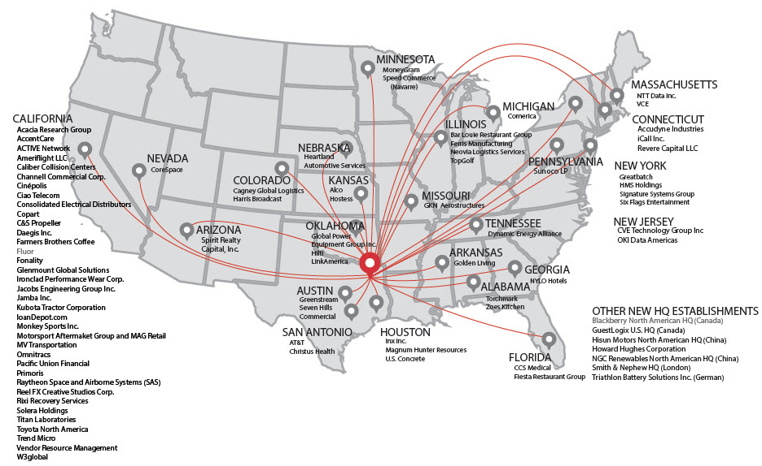
PROVEN SUCCESS
More than 70 HQ Relocations in Last 5 Years

Slide 5
DFW
OCCUPATIONAL
SNAPSHOT
1 - 3%
UNEMPLOYMENT RATE
IN KEY OCCUPATIONS
Management, Legal, Finance, Health Care,
Computers, Architecture & Engineering

Slide 6
Market the Dallas Region to attract and retain top talent from Texas, the U.S. and abroad
Advocate and promote quality of life initiatives that are most important to attracting and retaining talent

Slide 7
DRC TALENT ATTRACTION
2016: INFORMATION GATHERING
Nationwide Survey
1,000 Millennials
FOCUS GROUPS
Regional Assets
Availability & variety of jobs
Low cost of living
Regional Challenges
Public transportation
Commuting & traffic
61%
OF MILLENNIALS HAVE A FAVORABLE OPINION OF DALLAS
58%
OF MILLENNIALS WOULD CONSIDER MOVING TO DALLAS FOR THE RIGHT OPPORTUNITY

Slide 8
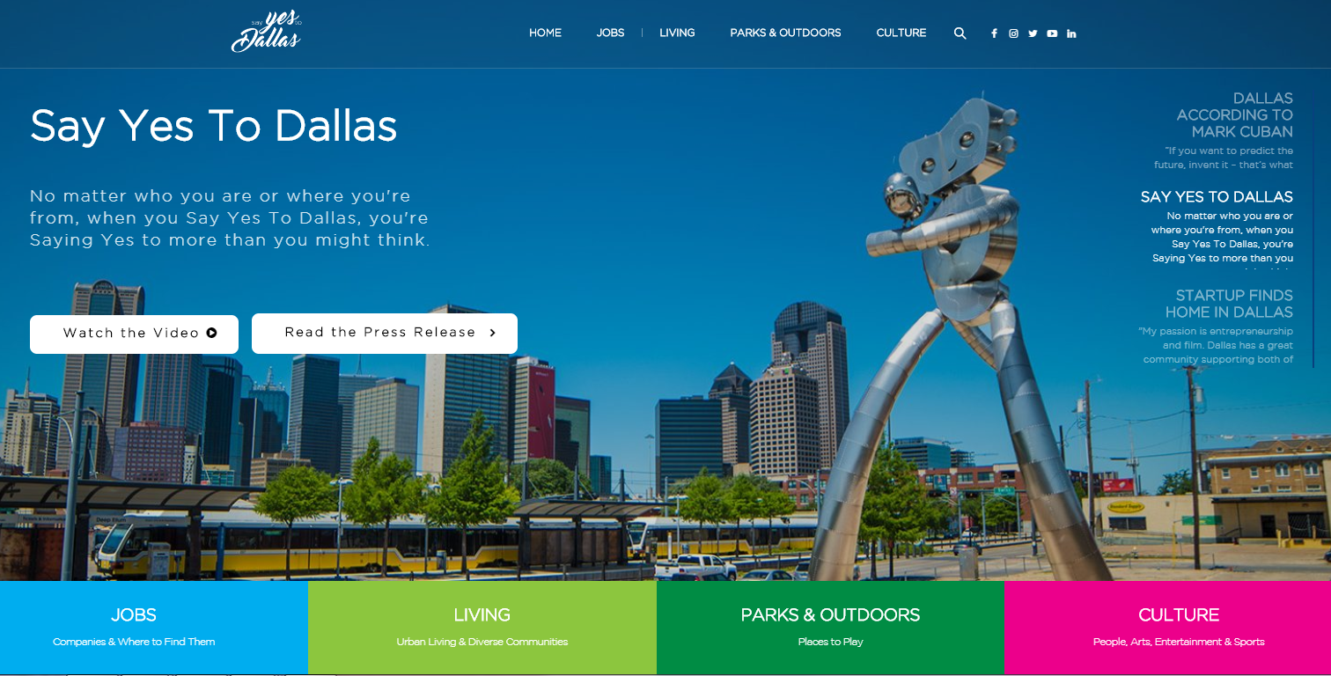
@ sayyestodallas | sayyestodallas.com
Notes:
A marketing campaign aimed to attract the best and brightest workers to the Dallas Region

Slide 9
@SAYYESTODALLAS
Post original content minimum 1-2 times a week with reposts daily
Post a minimum of 2 times daily, using the #SayYesToDallas hashtag
Post original content once a week, using the #SayYesToDallas hashtag

Slide 10
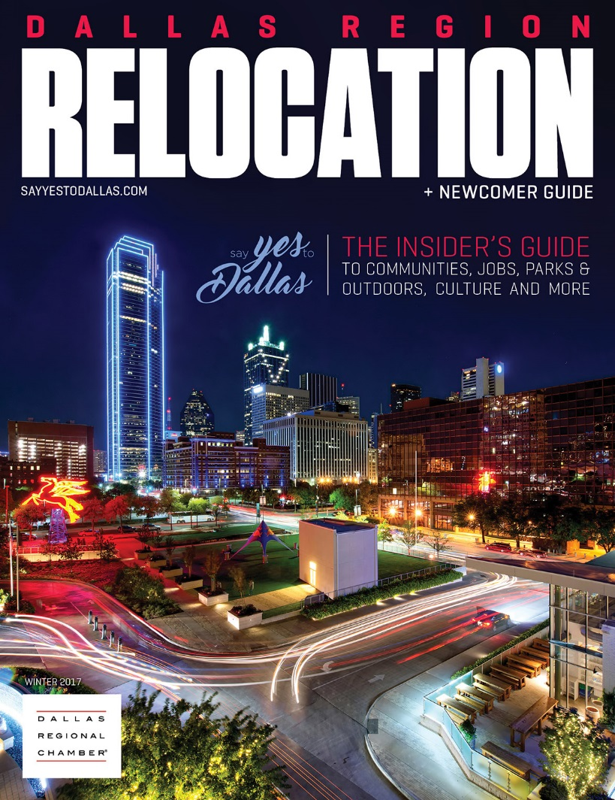
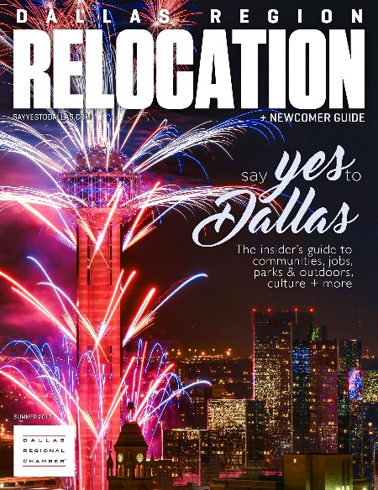
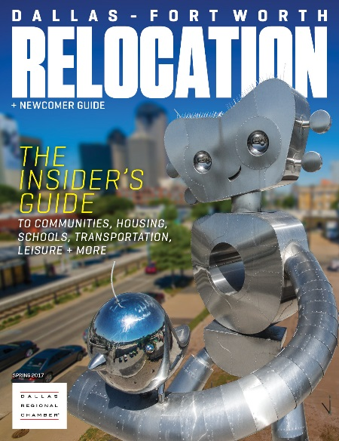
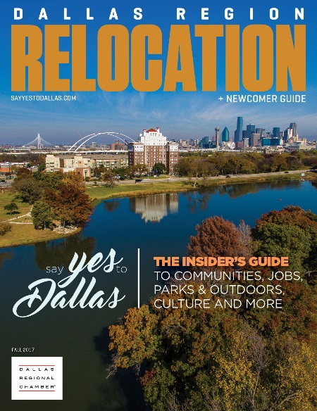
FREE QUARTERLY MAGAZINE

Slide 11
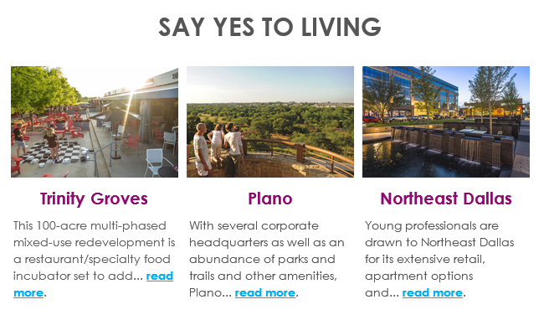
MONTHLY E-NEWSLETTER

Slide 12
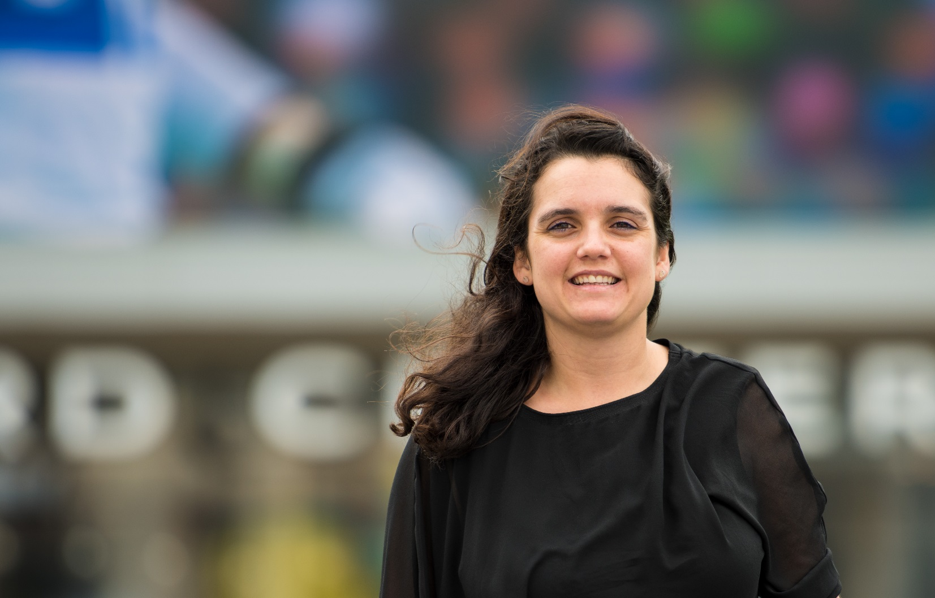
TESTIMONIALS
TO FRISCO, FROM FRANCE!
Sophie Sertier
“Frisco is a nice area with activities and nice people – a growing area, allowing us to always try new things and explore the city.
Read Sophie’s Story >
sayyestodallas.com/my-dallas-story

Slide 13
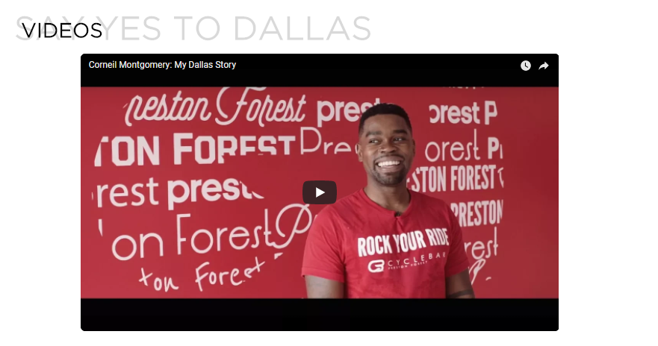
VIDEOS
sayyestodallas.com/videos

Slide 14
2017 NATIONWIDE SURVEY
National online survey of 1,000 U.S. Millennials 19 – 37 years old
Conducted by Hill + Knowlton Strategies November 30 – December 3, 2017

Slide 15
KEY FINDINGS
More than four in ten say they are open to relocation or actively seeking to move.
Promoting Dallas’ affordability is a major opportunity to attract new talent
Dallas is positioned favorable on key attributes (cool/fun, diverse, innovative & progressive)
Notes:
Promoting Dallas’ affordability is a major opportunity to attract new talent.
Dallas leads all cities tested on affordability ratings.
Affordability is top of mind – when asked to give their most important reason for choosing a city aside from job opportunity, affordability/cost of living ranks only behind location of loved ones.
Salary and cost of living were listed as top reasons not to relocate to a particular city.
Affordability leads other factors by a wide margin when considering living in a large city.
More than half say they would want to be able to buy a home within two years of moving to a new city.

Slide 16
MOVING CONSIDERATIONS
Denver, Seattle, San Francisco, and Austin rank highest in terms of desirability for millennials. Dallas ranks comparably to Chicago and
San Antonio, and its position relative to 2016 is unchanged.
Rank Order
2016
San Francisco
New York
Los Angeles
Seattle
Chicago
Denver
Atlanta
Philadelphia
Dallas
Austin
Charlotte
San Antonio
Rank Order
2017
Denver
Seattle
San Francisco
Austin
New York
Charlotte
Los Angeles
Chicago
Dallas
San Antonio
Atlanta
Philadelphia

Slide 17
WILLINGNESS TO MOVE
One-third say they would consider moving to a new city; one in ten say they are actively looking to move.
 |  | Top 2 box: Would consider/Actively looking
Total |  | 43%
Gender | Male | 37%
 | Female | 48%
Age | 19-27 | 47%
 | 28-31 | 43%
 | 32-37 | 39%
Income | <$50K | 49%
 | $50K-$100K | 40%
 | $100K+ | 38%
Region | Northeast | 40%
 | Midwest | 47%
 | South | 44%
 | West | 39%
Top 2 box: 43%
7%
OCT 2016:
50%
24%
19%
7%
Notes:
The percentage (43%) saying they are willing to move has increased considerably since 2016 (26%)
More than half say they would want to be able to buy a home within two years of moving to a new city.

Slide 18
MOVING CONSIDERATIONS
Affordability surpasses other factors in terms of importance when considering a place to live followed by family environment/schools and infrastructure/parks.
Question: Please indicate how important each of the following items is in considering living in a large city.
Use a 0-10 scale with 0 being not important at all and 10 being extremely important.
Communications
Prioritization
Primary
Second tier
Third tier

Slide 19
AFFORDABILTY
Dallas leads all cities tested on affordability – a key factor in choice of city in which to live.
Question: Please rate how well the term below describes each of the following cities:
64%
64%
61%
57%
15%
12%

Slide 20
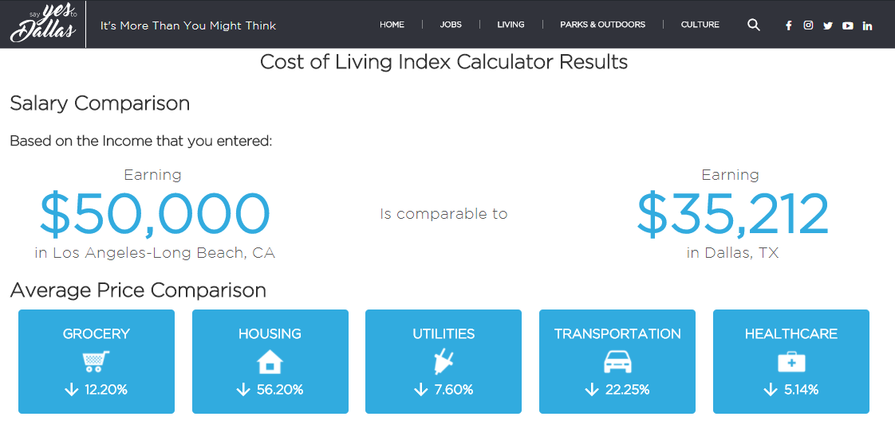
CALCULATOR
sayyestodallas.com/cost-calculator/
Notes:
Key Message:
Texas is one of only seven U.S. states with no state income tax and Dallas ranks in the top 10 U.S. cities with the highest pay adjusted to cost of living.

Slide 21
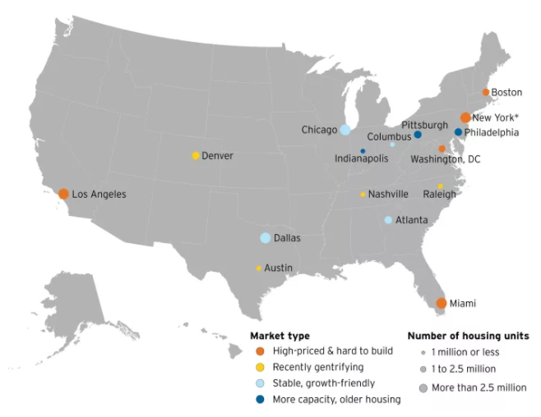
Notes:
https://www.brookings.edu/blog/the-avenue/2018/01/19/which-metros-have-enough-housing-capacity-to-absorb-amazons-hq2/?utm_campaign=Brookings%20Brief&amp;utm_source=hs_email&amp;utm_medium=email&amp;utm_content=60103947
“Atlanta, Chicago, Columbus, and Dallas – have traditionally had stable housing markets that accommodated population growth without price spikes. Unlike the Northeast and West Coast metros, their local governments have tended to allow new housing development without onerous regulations. Excluding Columbus, these metros also have substantial amounts of Class A office space in their downtowns. This group offers the highest likelihood of absorbing HQ2 with relatively minimal disruption to the existing housing market.”

Slide 22
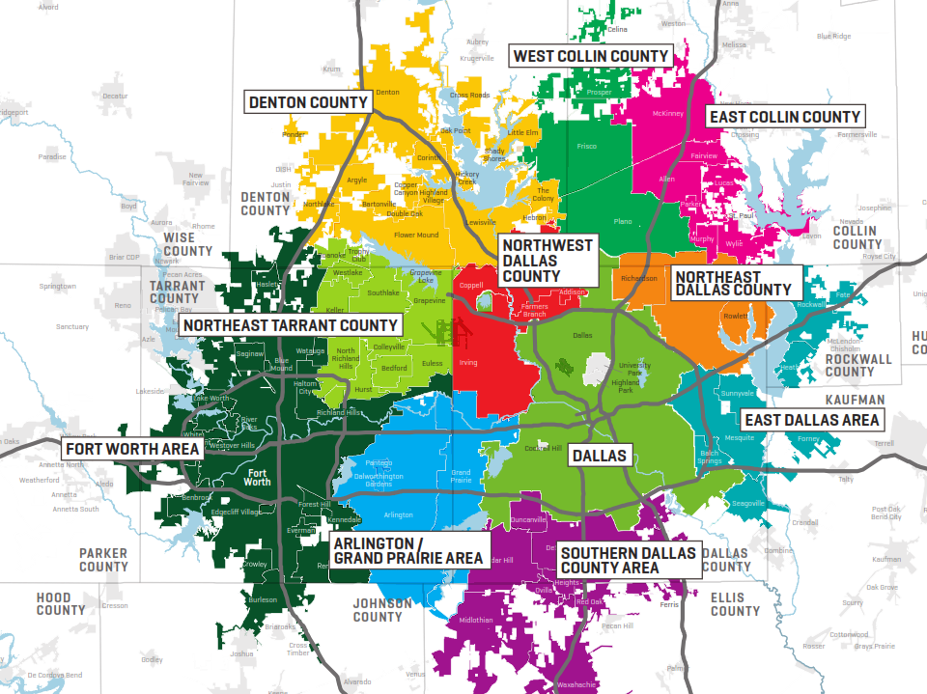
LIVING
sayyestodallas.com/living
sayyestodallas.com/cost-calculator/
Notes:
Key Message:
More than 200 cities, each with its own identity and culture makeup the entire Dallas Region.
To help people understand living opportunities in the Dallas Region, we’ve grouped communities into 12 distinct areas.
Urban Living
Dallas Neighborhoods
East Dallas Area
Northeast Dallas County
Northwest Dallas County
Southern Dallas County
East Collin County
West Collin County
Fort Worth Area
Northeast Tarrant County Area
Denton County
Arlington & Grand Prairie Area

Slide 23
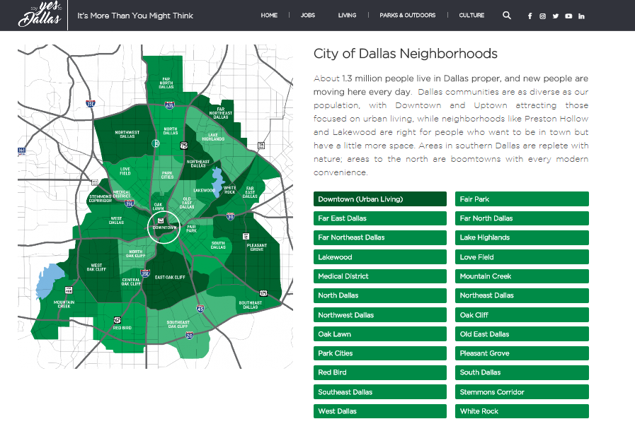
DALLAS NEIGHBORHOODS
sayyestodallas.com/cost-calculator/

Slide 24
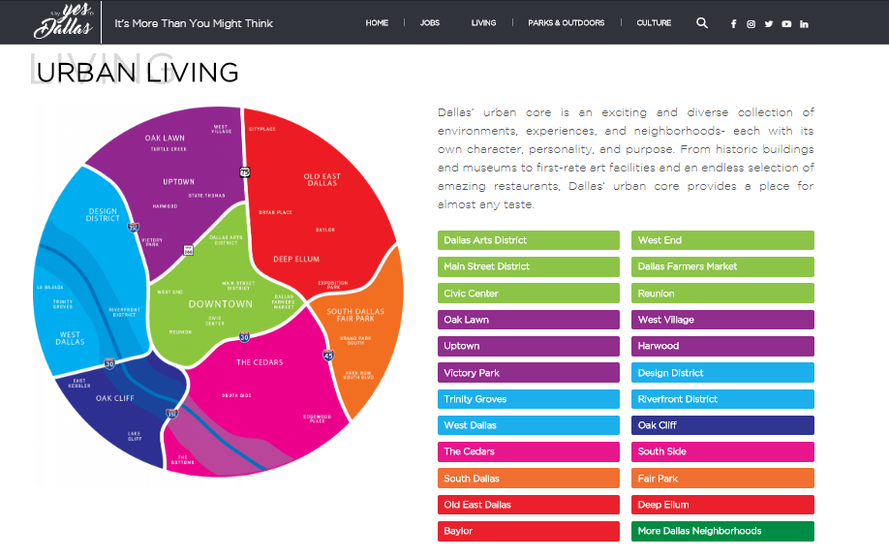
URBAN LIVING

Slide 25
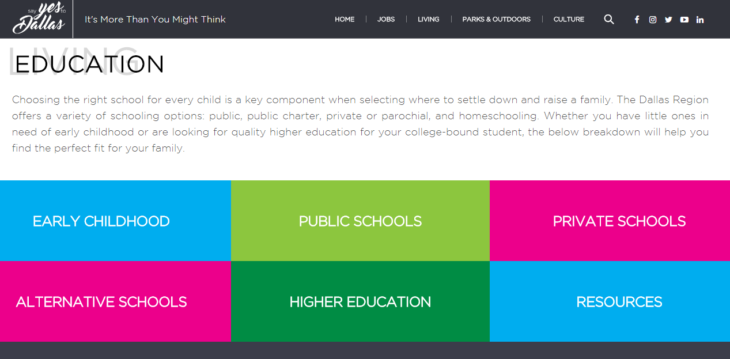
EDUCATION
sayyestodallas.com/living/education

Slide 26
GETTING AROUND
sayyestodallas.com/living/getting-around
Notes:
Key Message:
2017 traffic scorecard by INRIX, a leader in transportation analytics and connected car services (http://inrix.com/scorecard/), measures congestion by combining anonymous, real-time global positioning system probe data from 300 million connected cars and devices with real-time traffic flow data and other criteria, such as construction and road closures.
LA, NYC, San Francisco, Atlanta, and Miami rank as the most congested cities in the United States.
A few U.S. cities got some good news, including Dallas. Traffic congestion rates actually fell in the Texas municipalities of El Paso (-13%), Austin (-9%) and Dallas (-9%).
In Dallas, INRIX noted that 18 miles of new TEXpress Lanes opened in May 2017 on the Interstate 35E corridor that connects Dallas and Denton counties. The lanes carry traffic south toward Dallas in the morning and then north toward Denton in the afternoon.

Slide 27
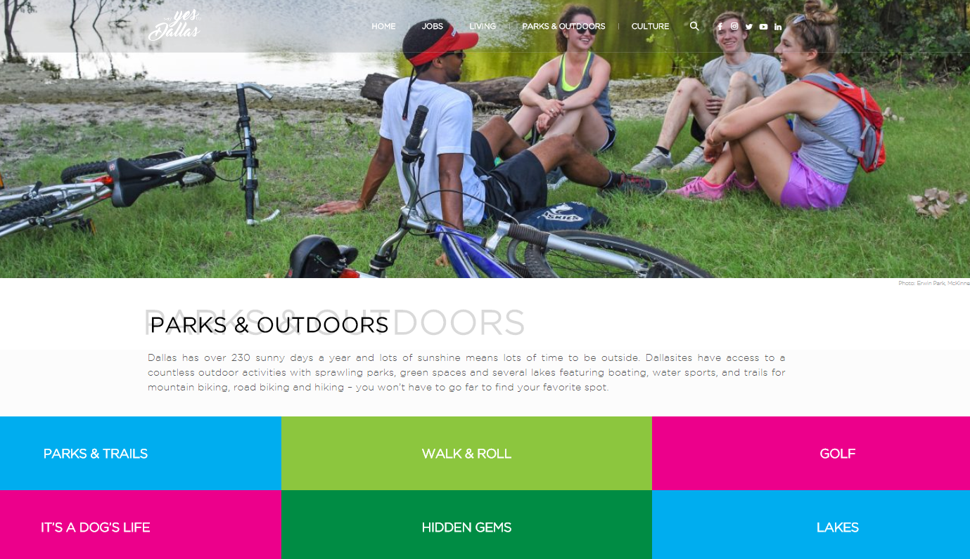
PARKS & OUTDOORS
sayyestodallas.com/parks-outdoors
Notes:
Key Message:
On average, there are over 232 sunny days a year in Dallas, and lots of sunshine means lots of time outside.
Dallas has more than 380 parks totaling over 23,242 acres of development and undeveloped parkland, the Dallas Park System is one of the largest municipal park systems in the nation.

Slide 28
Essential information you can share with your candidates about all the reasons to Say Yes To Dallas
ESSENTIALS GUIDE
DALLAS REGIONAL MAP
MY DALLAS STORY TESTIMONIALS
DALLAS MYTHBUSTERS
WEEKEND GUIDE
HIDDEN GEMS
MOVING CHECKLIST
24 THINGS TO DO IN FIRST 30 DAYS
7 TO FOLLOW ON SOCIAL MEDIA
IMPORTANT LAWS
sayyestodallas.com/essentials-guide
Notes:
An Essentials Guide you can send to candidates with fun things like:
A Regional Map grouping communities into 11 areas to help candidates better understand living opportunities in the Dallas Region
A Library of My Dallas Story Testimonials
Top 9 myths about the Dallas Region to help candidates understand what locals really know and love about Dallas.
A Weekend Activities Guide – with our best places to eat, drink, and go in Dallas that will surely make your candidates want to stay longer (maybe even forever).
From green spaces to your ‘Dallas’ playlist, your candidates can explore hidden gems to get them settled, save some cash, & live like a local.
Once we’ve sold them on Dallas, they’ll need an 8 week moving check list to get them from there to here. And once they’re here, they’ll need to know…
24 things to do in their first 30 days in Dallas to help candidates make connections, get established and feel at home – including how to get a Texas Driver’s license, register to vote, and learn about Dallas with our list of Instagram-worthy spots, family activities guide, and 7 people to follow on social media who best capture what the Dallas Region is all about.
Laws vary from state-to-state, city to city, so your candidates need to know which laws may be different in Texas and/or the area they plan to live.
Lastly an interactive cost of living calculator comparing the difference between metro areas for salary and costs for housing, groceries, utilities, transportation, and healthcare. But they shouldn’t take our word for it; they’ll have to use our cost calculator to see how we stack up!

Slide 29
QUESTIONS?
Jessica Heer
Dallas Regional Chamber
jheer@dallaschamber.org
(214) 746-6691
Notes:
JESSICA

