Slide 1
GENERATIONAL CONSIDERATIONS FOR RELOCATION PROFESSIONALS
Presented By:
Jennifer Manis Manager – International HR Center of Excellence
April 2017

Slide 2
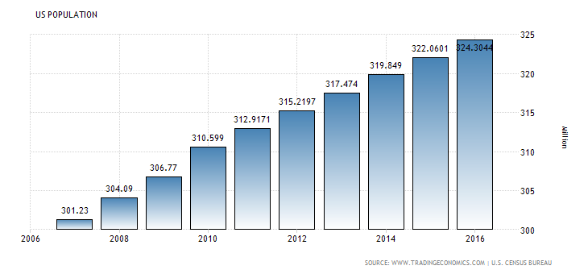
WHERE ARE WE NOW ? Some current demographics: US Population

Slide 3
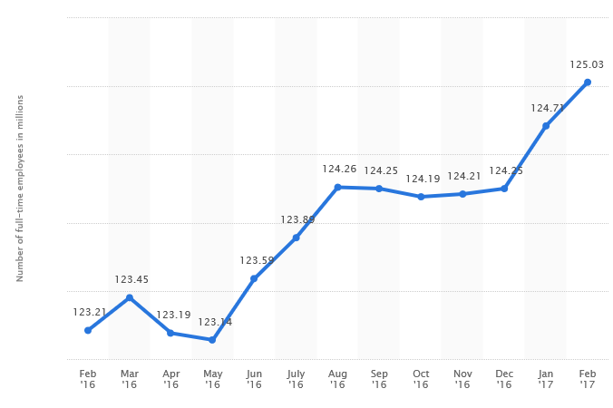
WHERE ARE WE NOW ? Some current demographics: Growth in US Employment past year
Used with permission Statista.com based on data compiled from the US Bureau of Labor Statistics, February 2017

Slide 4
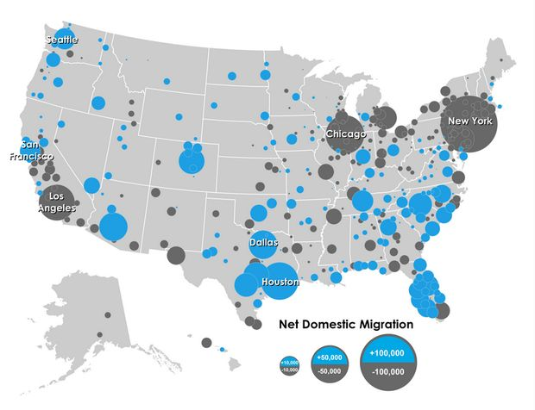
WHERE ARE WE NOW ? US Domestic Migration 2014-2016
Data compiled and made public by US Census Bureau

Slide 5
GENERATIONAL DIFFERENCES – A Review
Traditionalists – Ages 70 and above
Hard work and loyalty reaps reward
Figure things out for yourself
Don’t complain
Baby Boomers – Ages 50/52 to 70
Hard work reaps reward
Respect authority; Success = authority and respect
Driven to lead not follow
Generation X – Ages 35 to 50/52
Independent & self-absorbed; My unique abilities deserve rewards
Multiple career interests and paths over the course of a career
First generation to use technology in all aspects of life
Skeptical - Believes the “grass is greener” elsewhere
Generation Y or Millennials – Ages 17-35
Creative problem solving reaps rewards
Avoid boring or menial tasks always
Expect and demand technology in all forms
Individualistic – life should not have a “dress code”

Slide 6
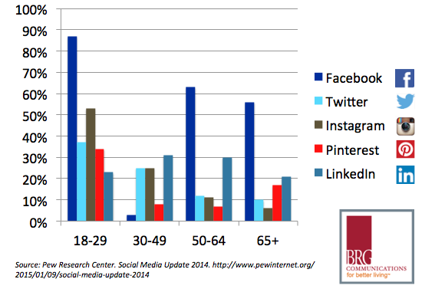
FUN FACTS: The Generations Use Social Media!

Slide 7
GENERATIONAL DIFFERENCES – Specifics for Relocators
Traditionalists – Ages 67/70 and above
No questions asked; No services demanded
Moving for work = money and loyalty
Worked hard and figured things out for themselves
Slow to accept change
Not culturally sensitive
Most leaving/left the workforce
Baby Boomers – Ages 50/52 to 67/70
Crave stability and respect
Moving for work = promotion/leadership opportunities
Seek some work/life balance and services for spouse
Embraces change
Began to recognize need for and demonstrate cultural sensitivity if relocated
Some nearing maximum work age limits; Also looking to retire earlier

Slide 8
GENERATIONAL DIFFERENCES – Specifics for Relocators (cont’d)
Generation X – Ages 35 to 50/52
Moving for work = new challenge and reward for unique abilities
Accompanying families demanding services
Often highly educated and utilizing technology
Generally internationally minded and culturally sensitive
Demand competitive pay over other recognition and will move to get it
Not loyal to a single employer
Generation Y or Millennials – Ages 17-35
Moving for work = company’s investment in future loyalty
Highly educated with advanced technology skills
Adventurous travelers – culturally sensitive and adaptable
Find most services cumbersome and unnecessary – could do it better themselves
Demand fast career progression and will move to get it
Remains to be seen if they will be loyal to a single employer

Slide 9
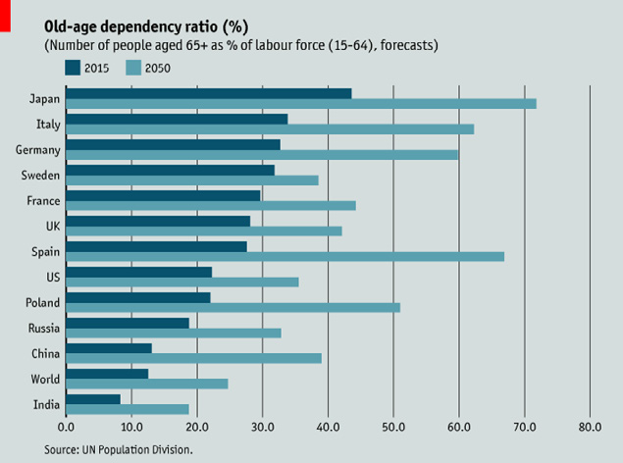
FUN FACTS: Global Aging Trends

Slide 10
GENERATIONAL DIFFERENCES IN COMMUNICATION
Traditionalists – Ages 70 and above
Detail-oriented
Prefer detailed written instructions
Don’t often offer opinions without being asked
Meet deadlines
Don’t complain
In-person conversation over emails
Slow to adopt change
Baby Boomers – Ages 50/52 to 70
Read body language well
Prefer phone call or in-person conversation
Will argue a cause to the bitter end
Great readers, thinkers and analyzers
Writes in “memos”
Demand much from co-workers
Excellent team players
Embraces change

Slide 11
GENERATIONAL DIFFERENCES IN COMMUNICATION
Generation X – Ages 35 to 50/52
Email preferred
Familiar with & uses technology
Strives for recognition – needs regular feedback
Quick to offer feedback
Keeps meetings short
Prefers to work independently
Visual presentations preferred
Generation Y or Millennials – Ages 17-35
Demands and uses all available technology
Short, quick emails & texts
Avoids menial tasks
Short visual presentations preferred
Wants to work in teams
Communicates to all as an equal
Offended by stern talking or “talking down to”

Slide 12
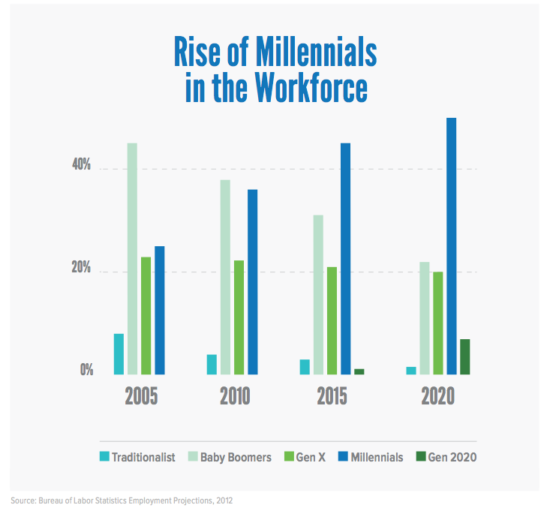
WHERE ARE WE HEADED? More Demographics – Generation Gap

Slide 13
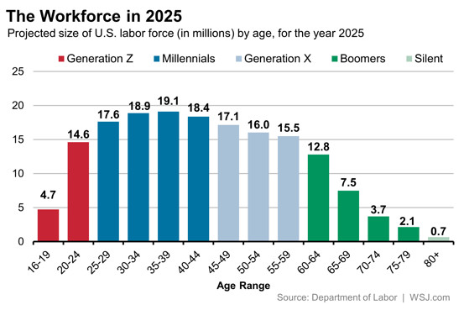
WHERE ARE WE HEADED? More Demographics – US Workforce

Slide 14
WHERE ARE WE HEADED ? More Demographics – International Gap
Millennials Generation X Baby Boomer & Traditionals
Age: up to 35 36-40 41-50 51 & over
2016 35% 14% 23% 28%
2013 16% 17% 33% 34%
2009 10% 19% 31% 40%
Amounts derived from publicly released survey data from HCR – UK and Expat Insider, Inc.

Slide 15
THE CHALLENGES
HOW DO WE - AS RELOCATION AND MOBILITY PROFESSIONALS - ATTRACT, RETAIN AND MOVE EMPLOYEES FROM AMONG ALL OF THE GENERATION GROUPS?
HOW DO WE SPECIFICALLY FIND WAYS TO FILL IN THE “SKILLS GAP” THAT EXISTS BETWEEN THE OLDER AND YOUNGER GENERATIONS IN THE WORKFORCE?

Slide 16
CONSIDERATIONS FOR A SUCCESSFUL RELO STRATEGY
Traditionalists – Ages 67/70 and above
Look to successfully ‘move toward retirement’
Communicate in detail and in person or on the phone
Develop knowledge transfer plans that honor Traditionalists
Engage. Ask.
Consider using as Consultants
Baby Boomers – Ages 50/52 to 67/70
Be cognizant of age limitations if moving internationally
Must address stability in any planned move
Provide “hands-on” services to the employee and spouse
Treat with respect in all encounters
Use as change leaders
Communicate directly when possible
Consider using as Consultants
Start to develop knowledge transfer plans

Slide 17
CONSIDERATIONS FOR A SUCCESSFUL RELO STRATEGY
Generation X – Ages 35 to 50/52
Utilize in start-ups, unusual or high risk projects
Recognize & provide service to families
Anticipate skepticism in the move process or in general
Keep engaged & challenged
Keep the job flexible – Gen X will not “live at work”
Provide regular, positive reinforcement and competitive pay
Generation Y or Millennials – Ages 17-35
Offer short term assignments or moves if available
Find modern ways to provide services
Partner with more experienced generations
Don’t misinterpret casual communication style as disrespectful
Frequent formal reviews and feedback including next steps

Slide 18
CONSIDERATIONS FOR A SUCCESSFUL RELO STRATEGY
Some Positive Steps Across All Groups:
Offer generational training
Establish mentoring programs that cross generations
Provide work options such as telecommuting
Develop training methods that accommodate different learning styles
Utilize a variety of recognition methods
Communicate important messages multiple ways
Deliver services with different levels of “direct touch” vs technology
Allow individuals and teams to decide how to deliver assignments
Always ensure your programs are non-discriminatory. It is particularly important to not disadvantage older workers in how you treat them at work or how you deliver services to them!

Slide 19
PRIMARY KEYS TO SUCCESS –
ONE SIZE DOESN’T FIT ALL
PLAN TO ACCOMMODATE GENERATIONAL DIFFERENCES
WHAT ABOUT CULTURE?

Slide 20
CHECK YOUR LEARNING
Traditionalists – “Slow down and learn from me”
“All you had to do was ask”
Baby Boomers – “Pick up the phone and talk to me”
“Be respectful – I have worked hard for a long time”
Gen X – “My family and I are a package deal”
“If this doesn’t work out I can always go
somewhere else”
Gen Y – “I am up for any adventure”
“I found a way to do that faster”
“Please don’t ask me to make copies”

Slide 21
QUESTIONS?

